Slide 1
STATISTICAL ORGANIZATION OF SCORES
PABLO S. CRESPO, JR.
University of Antique

Slide 2
RAW SCORES BY THEMSELVES ARE USELESS

Slide 3
The raw score of Gina in a test is 45. What does it mean?
She is better than 45% of her classmates.
She ranked number 45 in her batch.
She got 45% correct answer in the test.
She got 45 correct answers.

Slide 4
Raw scores by themselves are useless.
INORDER TO GENERATE INFORMATION FROM RAW SCORES THEY MUST BE SUBJECTED TO STATISTICAL TREATMENT

Slide 5
COMMON STATISTICAL TREATMENT
STATISTICAL MEASURES | PURPOSE
1.Measures of Central Tendency | To measure performance
2. Measures of Variability & Dispersion | To measure dispersion or spread of scores
3. Measure of Correlations | To measure relationship
4. Normal Distribution
5.Skewness & Kurtosis

Slide 6
Types of Data/Level of Measurement
The type of data you have generated or gathered determines the statistical scores you may apply.

Slide 7
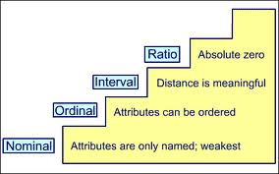

Slide 8
Types of Data
Nominal Data. The data that are used to label, classify or categorize.
( the lowest type of data)
Examples: Course, Religion, Year
Level, Nationality
Numbers can also be nominal
data but they don’t have less than or
greater than relationship

Slide 9
RESPONDENT | SEX
A | 0
B | 1
C | 1
D | 0
E | 0
F | 0
G | 0

Slide 10
Types of Data
2. ORDINAL DATA. The data that tell less than or greater than relationship.
The difference however is not equidistant that numbers here could not be subjected to mathematical computations.
Examples: Sibling Rank, Honor Rank

Slide 11
Sibling Ranks
First Child
2nd child | 9 months
3rd child | 1 year and 2 months
4th child | 3 years
5th child | 2 years

Slide 12
Types of Data
3. INTERVAL DATA. The data that tell of less than and greater than relationship, the differences between and among data are equal (equidistant)
Examples: scores in test, Fahrenheit and Celsius Scale

Slide 13
Scores in a 10-item tests
10 | Gap
9 | 1
8 | 1
7 | 1
6 | 1
5 | 1
4 | 1

Slide 14
Types of Data
4. RATIO DATA. The highest type of data that combine the characteristics of other data. There is greater than and greater relationship and the gap is equidistant. The difference between and ratio and interval data is in the zero. The zero in ratio data is absolute.
Example: income, weight gain, Kelvin temperature scale.

Slide 15
QUESTION
The score of the students in the test is what kind of data?
A. Nominal
B. Interval
C. Ordinal
D. Ratio

Slide 16
Other classification of data
DISCRETE
CONTINUOUS

Slide 17
REMEMBER THESE PAIRINGS
DATA | MEASURES OF CENTRAL TENDENCY | MEASURES OF VARIABILITY
NOMINAL | MODE | RANGE
2. ORDINAL | MEDIAN | QUARTILE DEVIATION
3. INTERVAL | MEAN | STANDARD DEVIATION
RATIO | MEAN | STANDARD DEVIATION

Slide 18
METHODS OF DATA REPRESENTATION
TEXTUAL
GRAPHICAL
TABULAR

Slide 19
Textual Data Representation (Words)
30 of 40 students or 75% got scores better than 15 in a test of 20 items.

Slide 20
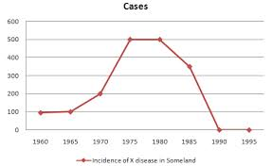
Graphical Representation: Line Graph/Frequency Polygon

Slide 21
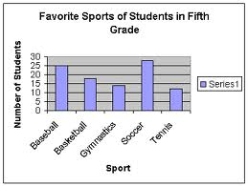
Bar Graph

Slide 22


Slide 23
Frequency Distribution
CLASS INTERVAL | F | M | CF< | CF>
31-35 | 3 | 33 | 30 | 3
26-30 | 7 | 28 | 27 | 10
21-25 | 10 | 21 | 20 | 20
16-20 | 6 | 18 | 10 | 26
11- 15 | 4 | 13 | 4 | 30

Slide 24
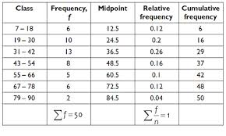
Tabular Data Representation: Frequency Polygon

Slide 25
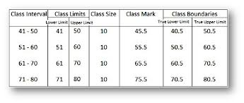

Slide 26
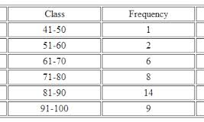

Slide 27
MEASURES OF CENTRAL TENDENCY
In an array of scores, can a teacher pick up a score that can represent the enter set of scores?
Consider these scores:
0, 1, 1, 2,2,3,3,3,5,5,6,6,6,7,7,7,8,8,8,9,10

Slide 28
MCT Defined
Scores which are usually found at the center of the distribution that can stand in behalf of the scores of the distribution. They are the averages and they are used to compare performance

Slide 29
Consider the example below. Which is the best performing class?
CLASS | MEAN
CLASS A | 45
CLASS B | 46
CLASS C | 43

Slide 30
What about this?
CLASS | MEAN | STANDARD DEVIATION
A | 35 | 4
B | 35 | 3
C | 35 | 2

Slide 31
THE MEAN
A teacher conducted 100-item tests in the Subjects Mathematics, Science and English in his class. The means of the class are as follows: English- 46, Mathematics- 53 and Science- 60. Is it a correct conclusion to say that the class performed the best in Science?

Slide 32
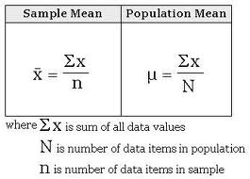

Slide 33
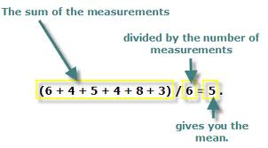

Slide 34
Characteristics of the Mean
1.The most stable & reliable measure of central tendency.
2.The most widely used.
3. The balanced point of the distribution.
4. Affected by extreme measure.
5. Used when data are interval & ratio.
6. Paired with standard deviation

Slide 35
3, 4, 5, 6, 7

Slide 36
mean

Slide 37
mean
mean

Slide 38
The mean is used to measure and compare performance of two groups that are normally distributed, when the distribution is symmetrical.

Slide 39
Sample exercises: The Mean
What is the mean of this data set?
14, 15, 16, 17, 18, 19, 20
2. In a certain science high school, in the computation of the GWA, 2x and 3x weights are given to Mathematics and Science respectively. What is the GWA of John if his grades are: English-87, Filipino-83, Science- 92, Math- 93 and Makabayan- 85?

Slide 40
What is the highest possible value that a score could take if the mean of the five scores is 8.? There is no duplication of scores.
A. 25 C. 30
B. 15 D. 22

Slide 41
90
88, 89, 90, ______

Slide 42
MEDIAN
The positional average. The measure of central tendency that tells position. It is a score that bisects the distribution into half.

Slide 43
Characteristics:Median
It tells position or location.
Divides the distribution into half.
Not affected by extreme measure.
Used when the data are ordinal
Paired with quartile deviation
Necessitates the arrangement of data.

Slide 44
7. Used to describe performance if the data are badly skewed or where there are many scores that are very high or very low or when the scores cluster in the tail of the curve.

Slide 45
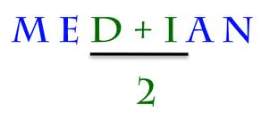

Slide 46
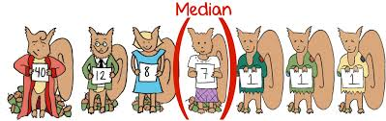

Slide 47
Sample Exercises:
What is the median of this data set?
5, 7, 9, 10, 12
What about is 12 in the data above is 120? Would that change the median.

Slide 48
3. What is the median?
1, 0, -2, 5, 4
4. Where can you find the median of 21 scores?

Slide 49
Consider this question:
The following represent the scores of students in a 100-item test:
99, 98, 94, 90, 90... 18, 8, 4, 3, 1
Which is the most appropriate measure of central tendency that can describe the scores?
A. mean B. median C. Mode

Slide 50
THE MODE
The most popular score; the score that appears the greatest number of times in the distribution.

Slide 51
Mode: Characteristics
1. Gives the quickest estimate of the centrality of scores through simple inspection.
2.The crudest measure of central tendency
3. Used when the data are nominal
4. Paired with range.

Slide 52

Question: Will the graph of a distribution with two modes which are close appear as bimodal?

Slide 53
The POINT MEASURES
The extension of the median concept?
They tell position or location.
The point measures are:
1.Quartile 3. Percentile
2. Decile 4. Stannine

Slide 54
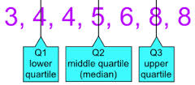

Slide 55
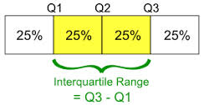

Slide 56
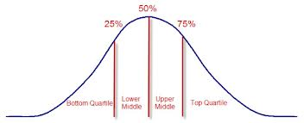

Slide 57
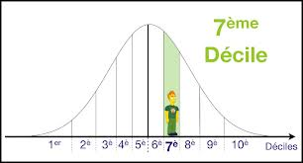
Decile

Slide 58
Percentile
A point in the distribution below which a number of cases lie.
QUESTION: John is 80 percentile in the
test. What does it mean?
A. John answered 80 questions.
B. John got 80% correct answer.
C. John got a score of 80.
D. John belonged to the upper 20%.

Slide 59
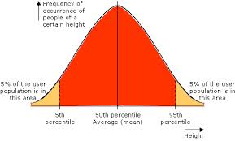

Slide 60
Percentile...
Question: Jay got a score of 35 which is equivalent to 85th percentile. What percent of the class have scores lower than 35?
A. 35 % C. 15 %
B. 85 % D. 65 %

Slide 61
PRACTICE SET
1. The teacher has computed the mean. What is the appropriate measure of variability he will compute next?
Standard Deviation C. Range
Variance D. Mode

Slide 62
2. If all of the following are present in a distribution, which will you use to measure the typical performance of a class?
A. Mean B. Median
C. Mode D. All of them

Slide 63
3. The scores of the students in an IQ test is what type of data?
A. Nominal C. Ordinal
B. Interval D. Ratio

Slide 64
4. The score of Alvin in a test is 56 which is equal to the 75th percentile. What percent of his classmates have scores lower than 56?
A. 65 A. 56
B. 75 D. 57

Slide 65
5. Where can you find the median of 17 scores? The ___ score.
A. 9th B. 8th
C. 7th D. average of A & B

Slide 66
6. What is the rank of 90 in this set of grades:
92, 91, 88, 90, 91,90, 89,
A. 3 C. 4
B. 4.5 D. 5

Slide 67
7. Data which are used to label or categorize re called as ________.
A. nominal data
B. interval data
C. ordinal data
D. ratio data

Slide 68
8. A zero in a test reperesents what type of data?
A. nominal
B. ordinal
C. nominal
D. ratio

Slide 69
9. If the teacher wants a quick estimate of the average performance of the class, he should use the ________.
A. Mean C. Mode
B. Median D. Range

Slide 70
10. Which of the following is will be definitely affected when a teacher fails to record a score in a test? The ____ of the scores.
A. Mean C. Mode
B. Median D. Variance

Slide 71
11. Which measure(s) of central tendency is/are appropriate if all of the students pass the test and many have perfect scores?
A. Mean C. Median
B. Mode D. Mean & Mode

Slide 72
12. Celsius and Fahrenheit temperature scales are what type of data?
A. nominal
B. ordinal
C. Interval
D. Ratio

Slide 73
13. When the scores cluster in the left side of the tail, it is _____________.
A. negatively skewed
B. positively skewed
C. skewed to the left
D. normal

Slide 74
For questions 14-15, refer to this data
8, -8, 4, -4, 0
14.What is the mean?
15. What is the median?

Slide 75
Measures of Variability and Dispersion
After you have computed a measure of central tendency, there is a need to compute a corresponding measure of variability.
Why?

Slide 76
Consider these data sets:
SET A = 1, 4, 5, 6, 9
SET B = 3, 4, 5, 6, 7
Compare the data sets in terms of the mean, median & mode.

Slide 77
What is variability?
Consider these scores.
7, 7 7 ,7 ,7
1, 2, 3, 4, 5

Slide 78
Limitation of the MCT
The MCTs do not give an accurate description of the data sets. It cannot describe the data in terms of distance, variability or dispersion.
Are the scores close? Are they widespread? Homogeneous? Heterogeneous? Only the Measures of Variability or Dispersion can answer these questions.

Slide 79
The Measures of Variability
1. Range
2. Average Deviation
3. Quartile Deviation
4. Standard Deviation
5. Variance

Slide 80
INTERPRETATATION
THE HIGHER THE VALUE DERIVED FROM ANY MEASURE OF VARIABILITY, THE MORE WIDESPREAD THE SCORES ARE. THE LOWER THE VALUE, THE CLOSER THE SCORES ARE.

Slide 81
Example:
WHICH OF THE FOLLOWING STANDARD DEVIATION VALUES YOU CAN FIND SCORES WHICH ARE WISESPREAD?
A. s=0.9 C. s= 0.6
B. s=0.5 D. s= 0.3

Slide 82
THE RANGE
The SIMPLEST and the FASTEST Measure of variability. Can be determined by simple inspection.
It is the also the crudest measure of variability.

Slide 83
Consider this:
SET A: 1, 4, 5, 6, 9
SET B: 3, 4, 5, 6, 7

Slide 84
WHAT IS THE RANGE?
0, 2, -3 , 4, 5

Slide 85
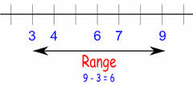

Slide 86
2. The Q
Quartile Deviation,sometimes called as the Semi-interquartile range measures the gap between the Q3 and the Q1 divided by 2.
Q = Q3 - Q1
2

Slide 87
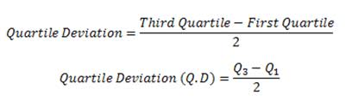

Slide 88
THE AVERAGE DEVIATION
The average deviation measures how the scores by average differ from the mean, the median or the mode.

Slide 89


Slide 90
Score | Mean | Score-Mean
3 | 4 | 2
4 | 4 | 1
5 | 4 | 0
6 | 4 | 1
7 | 4 | 2
Summation |  | 6
Average mean deviation is the square root of summation of the absolute value of the difference of the scores and the mean divided by the N
Square root of 6/5.

Slide 91
What is the mean average deviation of this data?
90 88 86 84 82

Slide 92
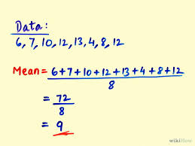

Slide 93
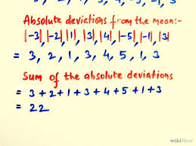

Slide 94
The STANDARD DEVIATION
The standard deviation is the measure of the distance of the scores from the mean. By how much, in average, the scores differ from the mean?
It is the average of the average

Slide 95
Example:
2 4 6 8 10

Slide 96
Consider this:
5 , 5, 5, 5, 5, 5,
WHAT IS THE STANDARD DEVIATION?

Slide 97
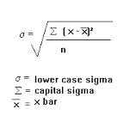

Slide 98
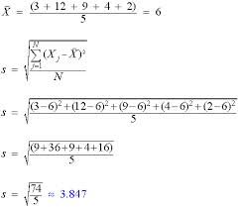

Slide 99
What is the standard deviation?
Score | Mean | Sum of (x-x)2
3 | 5 | 4
4 | 5 | 1
5 | 5 | 0
6 | 5 | 1
7 | 5 | 4
Summation |  | 10
SD is 10/5. Then get the square root.

Slide 100
Which has a lower standard deviation?
CONTES-TANT | Judge 1 | Judge 2 | Judge 3 | Judge 4 | Judge 5 | MEAN
A | 9 | 7 | 10 | 6 | 8 | 8
B | 7 | 7 | 9 | 8 | 9 | 8

Slide 101
Consider the data below:
CLASS | MEAN | STANDARD DEVIATION
CLASS A | 45 | 6
CLASS B | 45 | 3
CLASS C | 45 | 5

Slide 102
5. The VARIANCE.
The square of the standard deviation is the variance.
Q: What is the variance of the data with a standard deviation of 6?

Slide 103
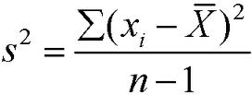

Slide 104
Standard deviation | Variance
10 | 100
6
 | 49
 | 25
11
9

Slide 105
If 5 points are added to every score in the distribution, how would change the:
1. Mean
2, Median
3. Mode
4. Range
5. Standard Deviation

Slide 106
THE NORMAL DISTRIBUTION
An assumption that most of the members of the population are average. The normal distribution is represented by the normal curve, a bell-shaped figure.

Slide 107
PROPERTIES OF NORMAL CURVE
The curve is symmetrical and bell-shaped.
The number of cases, N, is infinite.
The three measures of central tendency, mean, median and mode coincide at one point.

Slide 108
4. The height of the curve indicates the frequency of cases expressed as probability, proportion or percentage.
5. The basic unit of measurement is expressed in sigma units or standard deviations along the baseline

Slide 109
6. Two parameters are used to describe the curve.
7. There are three standard deviation units to the left and to the rights of the curve before the tail appear to touch the baseline.

Slide 110
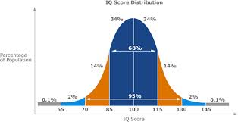

Slide 111
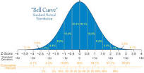

Slide 112
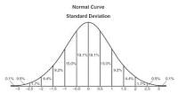

Slide 113
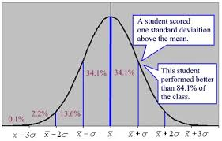

Slide 114
1. A distribution has a mean of 50 and standard deviation of 5. What do you expect to be the highest score assuming normality of the distribution?

Slide 115
In a test, the mean of the class is 85 and the standard deviation is 10. Assuming normal distribution,
A. What is the highest score?
B. What is lowest score?
C. What are the scores of the average students?

Slide 116
3. A test has produced a group mean of 50 and standard deviation of 7. What adjectival rating would you give to a student with a score of 48?
A. Average C. below Average
B. Above Average D. Poor

Slide 117
The Standard Scores
The standard scores are transformed raw scores.
Because they are transformed scores, they can be compared even though they come from different sources, subjects or even from test with different number of items.

Slide 118
Z = score - mean
standard deviation

Slide 119
SUBJECTS | SCORES OF JOHN | MEAN OF THE CLASS | STANDARD DEVIATION
English | 68 | 70 | 2
mathematics | 35 | 30 | 3
science | 59 | 64 | 5

Slide 120
SUBJECTS | JOHN’S SCORE | MEAN OF THE SCORE | STANDARD DEVIATION
FILIPINO | 100 | 110 | 5
HISTORY | 90 | 110 | 7
MAPEH | 75 | 70 | 2

Slide 121
SUBJECTS | SCORES OF LANZ | MEAN OF THE CLASS | SD
PHILOSOPHY | 25 | 25 | 3
HUMANITIES | 40 | 35 | 2
RELIGION | 60 | 70 | 5
VALUES EDUCATION | 45 | 48 | 1.5

Slide 122
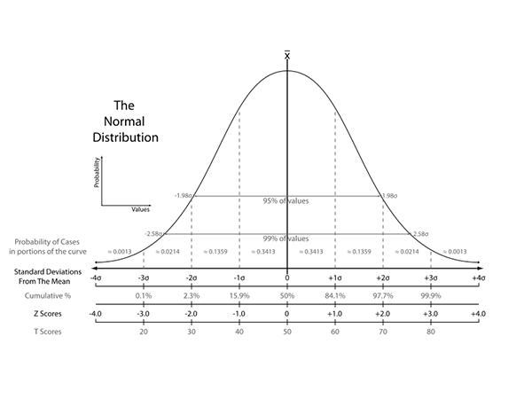

Slide 123
SKEWNESS
Refers to the asymmetry of the distribution. A distribution is skewed is the scores clusters at the either side of the tail. The curve is not balanced.

Slide 124
Skewed to the right or positively skewed- the tail extends to the right side of the curve, while the scores clusters on the right, thus, most values are low, test is difficult.
the mean is the highest value followed by the median and the mode.

Slide 125
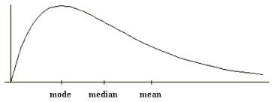

Slide 126
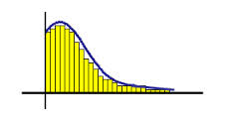

Slide 127
2. Skewed to the left- the tail extends to the left, but the scores cluster in the right side, thus, most values are high.
- the mode is the highest value, followed by the median and the mean.

Slide 128
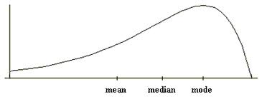
Skewed Left

Slide 129
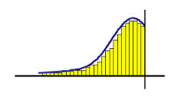

Slide 130
Tell whether the following are skewed to left or skewed to the right.
1. salaries of janitors
2. weight and height of malnourished children
3. height of PBA players
4. Scores of students in easy test
5. Grades of students in Calculus
6. NAT performance of students in special science class

Slide 131
7. LET ratings of the topnotchers.
8. mean = 56, median = 50
9. marrying age of people in the mountainous areas.
10. Average height of the Filipinos taken in a census

Slide 132
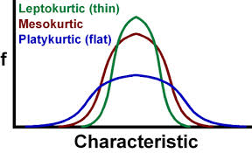
KURTOSIS

